Slide 1
Book Buddy Sprint 2 Update
Team 5 - Code Avengers
Pace University Capstone Project - Spring 2024

Slide 2
Agenda
Project Review
MVP
Technologies
Algorithms
Diagrams
Product and Sprint Backlog
Metrics
Retrospective
Sprint 3 Plans
Demo

Slide 3



Team Members
Jimmy Karoly
Scrum Master/Developer
Dhanasri Salla
Machine Learning Engineer
Sai Sandeep Mandava
Machine Learning Engineer

Slide 4


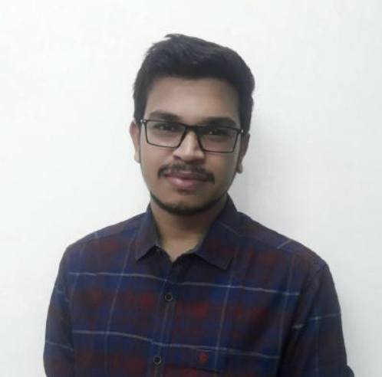
Team Members
Praveen Raj Gujju
Tester
Anusha Meka
Developer
Sairam Vinjamoori
Developer

Slide 5

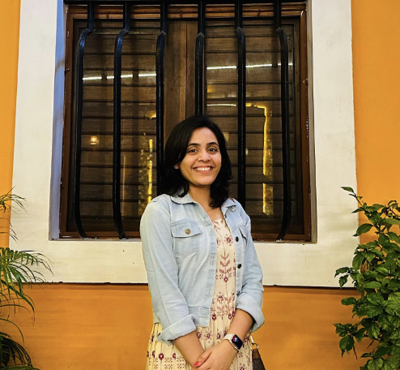
Team Members
Krushal Rama
Developer
Alekhya Bommineni
Developer

Slide 6
Changes due to Professor’s Feedback
Added pictures to Team Members slide
Added explanation of how we are using the technologies
Added algorithms slide
Added full project backlog
Deleted market analysis slide, as it was unneeded
Changed project description to use template
Slides with changes have this icon:

Slide 7
Problem Statement
Recommendation systems are incredibly important to how users find new products, information and suggestions. These systems are great but can have biases in what they recommend. This is especially prevalent in the book industry where recommendation systems tend to prioritize white authors and authors that are more popular, this leads to people getting a less diverse set of recommendations instead of truly discovering things that are different that they might like.
It’s important for people to get information from a variety of different voices with different experiences than their own, unfortunately most recommendation systems limit exposure to different perspectives.
We intend to research and develop a way for readers to find new authors that are under the radar and authors that have different life experiences. The application will combine this recommendation system with an e-commerce site where the user can purchase the books that are recommended.

Slide 8
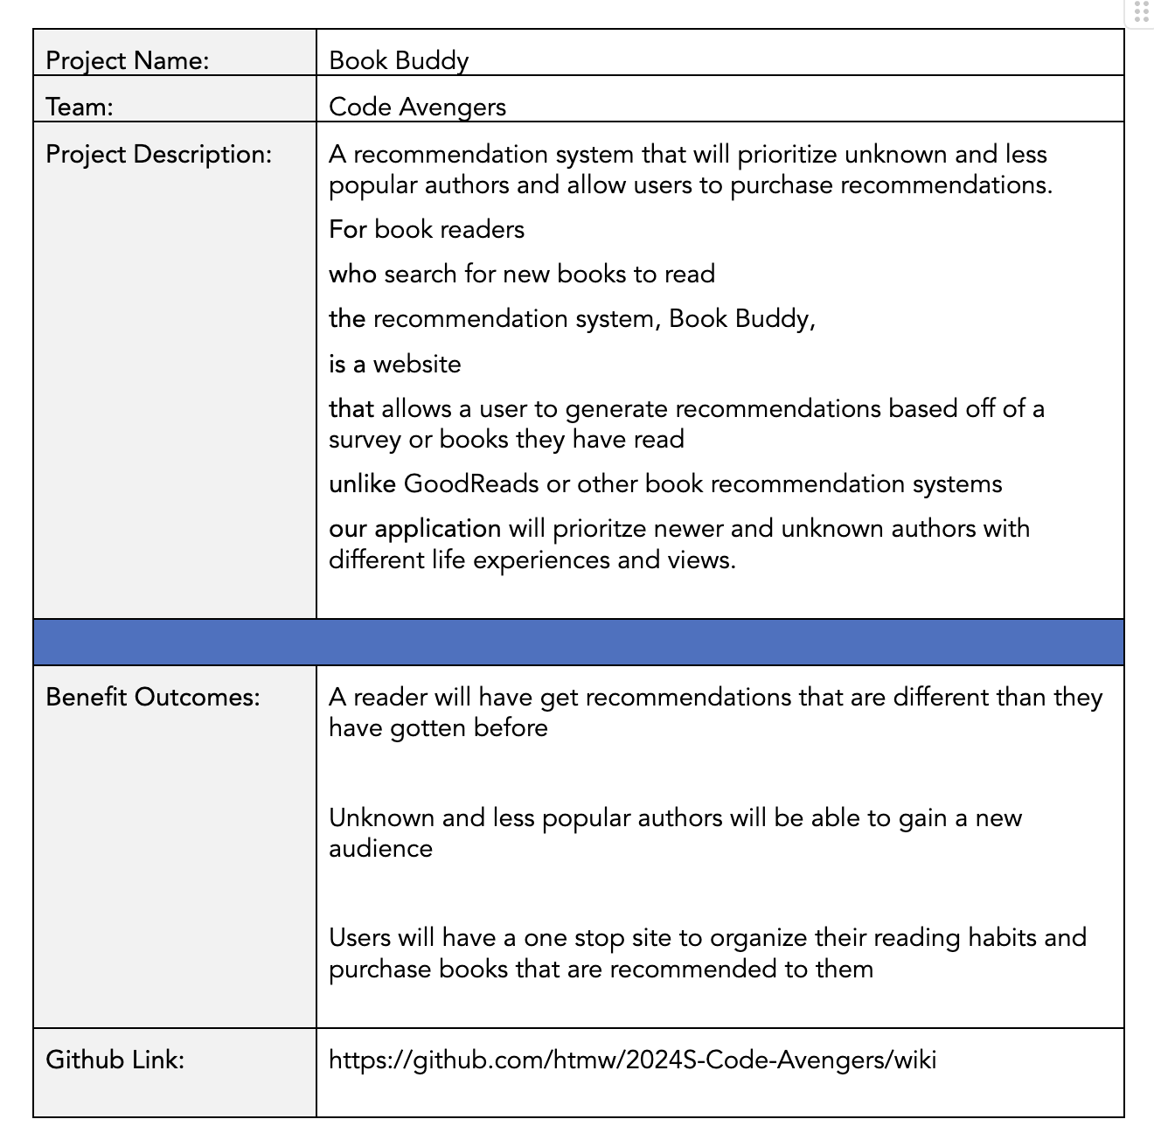
Project Description

Slide 9
Personas

Slide 10
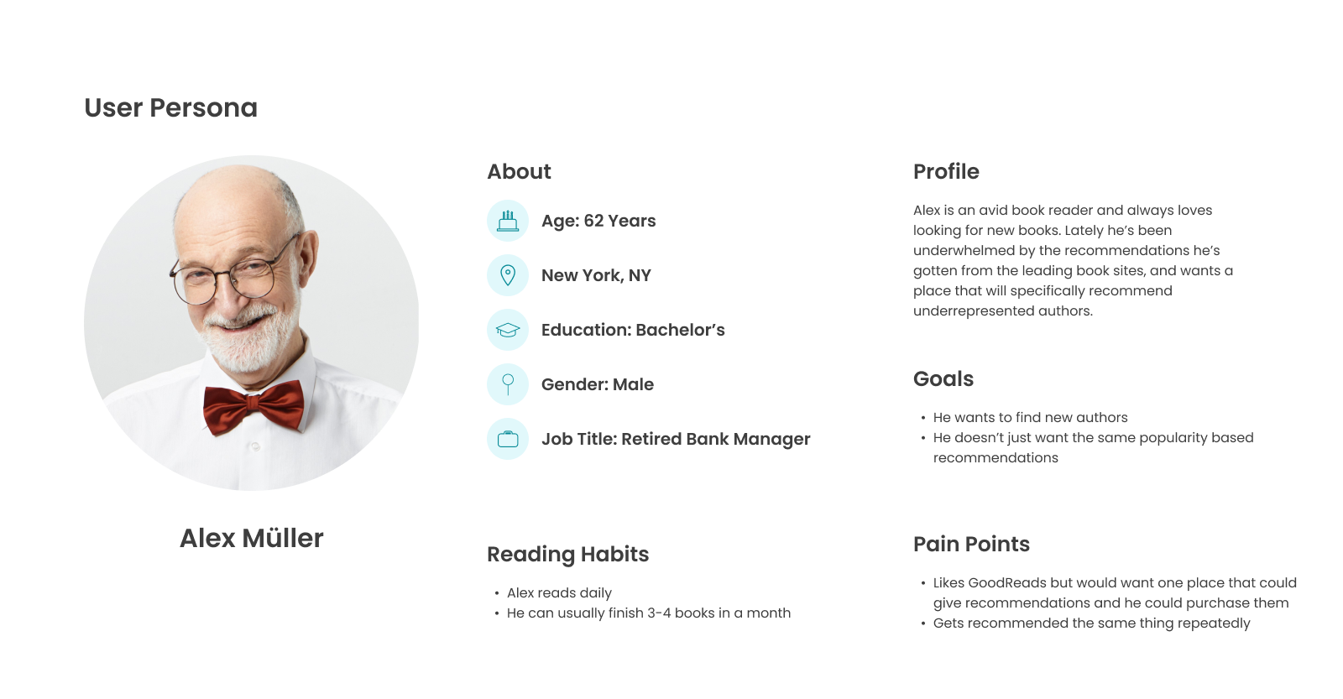

Slide 11
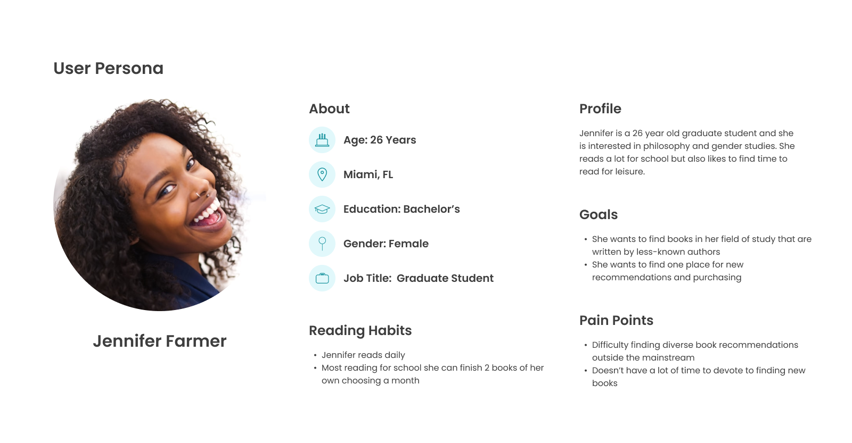

Slide 12
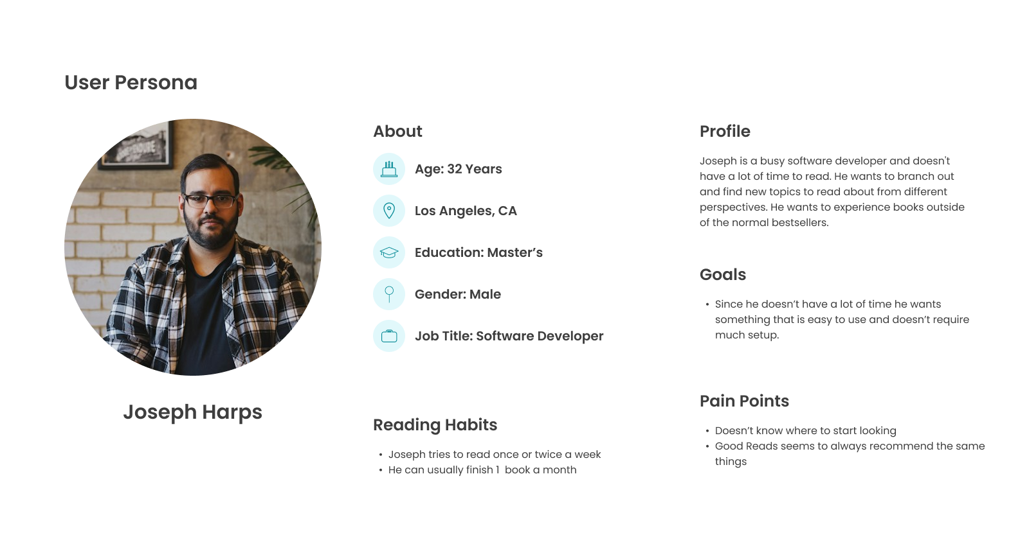

Slide 13
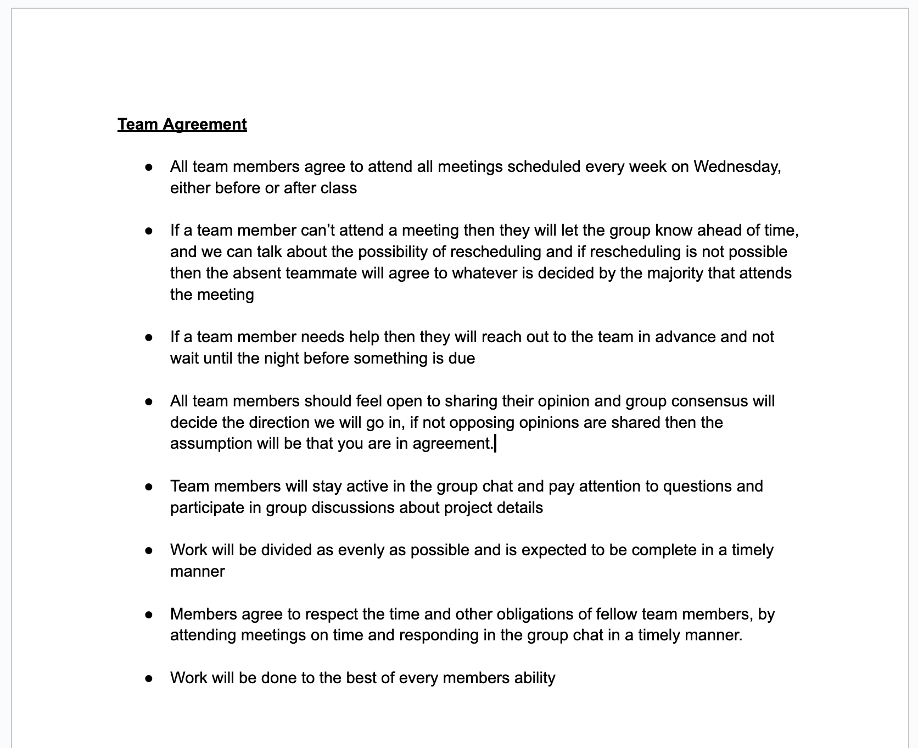
Team Working Agreement

Slide 14
Minimum Viable Product
Our MVP will consist of the following functionalities:
Registration/Login
Book Recommendations
Book Collections for User
Marketplace Functionality

Slide 15




Front End Technologies
We will be using the React JS library to create our UI along with some HTML and CSS as well.
For our login/registration we will be using Google Firebase. They allow you to interact with it through an API

Slide 16




Back End Technologies
We are using PyTorch for our ML Algorithm
We will create an API for the algorithm using Python
The backend will be written in Java using the Spring Framework
Our Database will be Postgres

Slide 17
ML Algorithm
Feature Vector Construction:
Represent each book as a vector of features. Each dimension corresponds to a specific characteristic or keyword associated with the book.
For textual features, use techniques like TF-IDF to weight the importance of each word or tag.
2. Cosine Similarity Calculation:
Calculate the cosine of the angle between two book vectors, A and B, using the formula:
Cosine Similarity = (A⋅B)/‖A‖‖B‖
Where:
A⋅B is the dot product of vectors A and B
‖A‖ and ∥B∥ are the magnitudes (Euclidean norms) of vectors A and B, respectively.
3. Interpretation:
The cosine similarity ranges from -1 to 1, where 1 means identical, 0 indicates orthogonality (no similarity), and -1 implies opposite.
For book recommendations, we focus on positive similarity scores, with higher scores indicating greater similarity.
4. Recommendation:
For a target book, calculate its cosine similarity with all other books in the dataset.
Recommend books with the highest similarity scores to the reader.

Slide 18
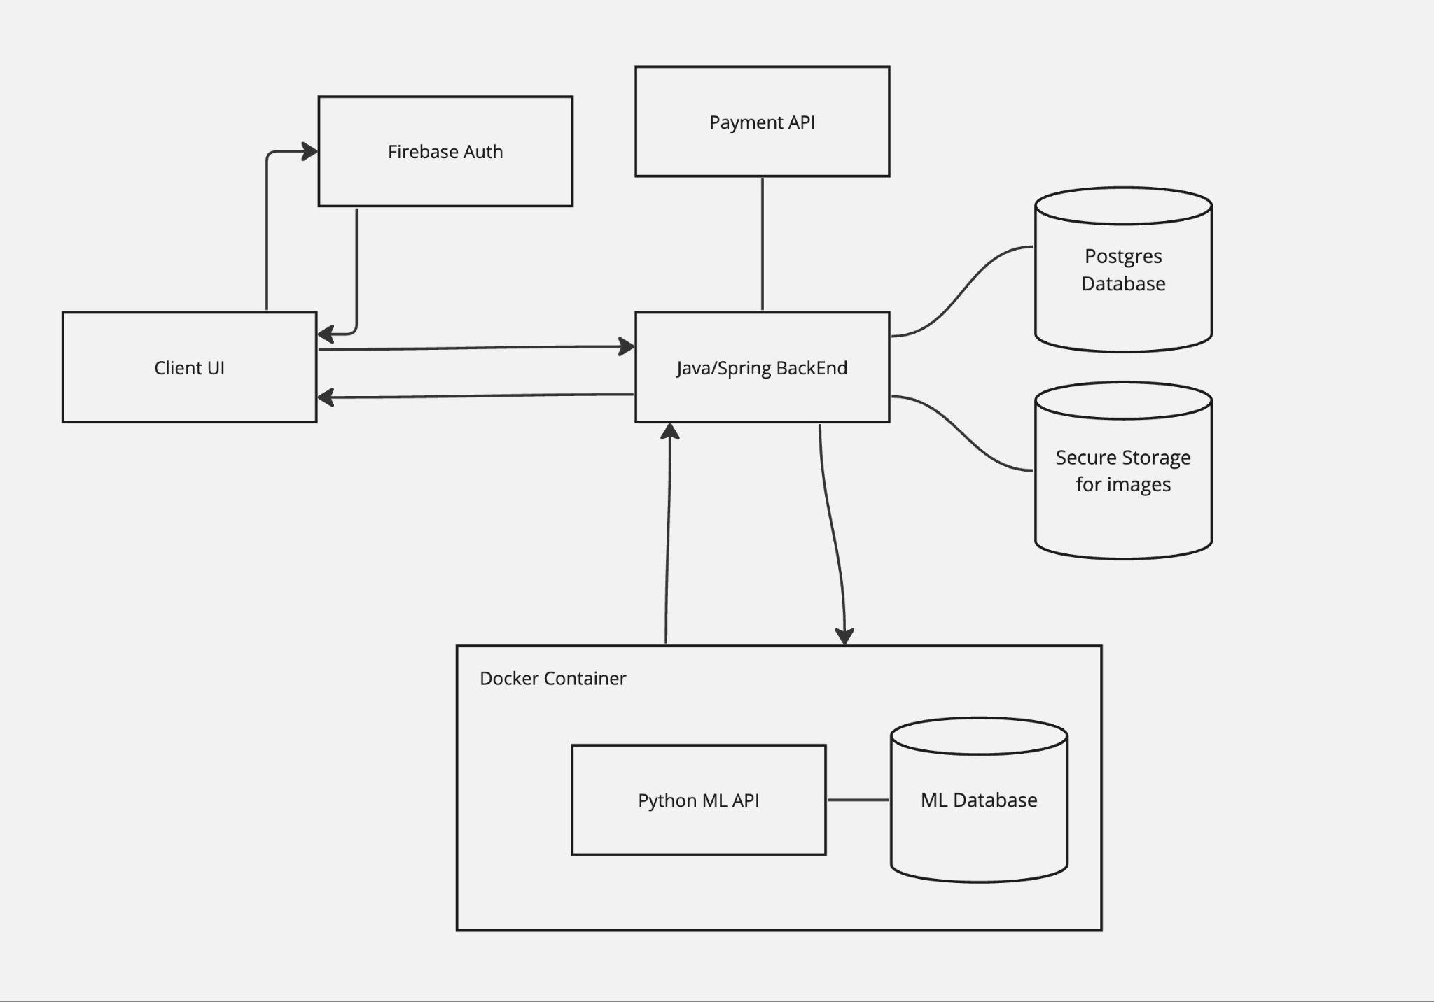
Conceptual Architecture Diagram

Slide 19
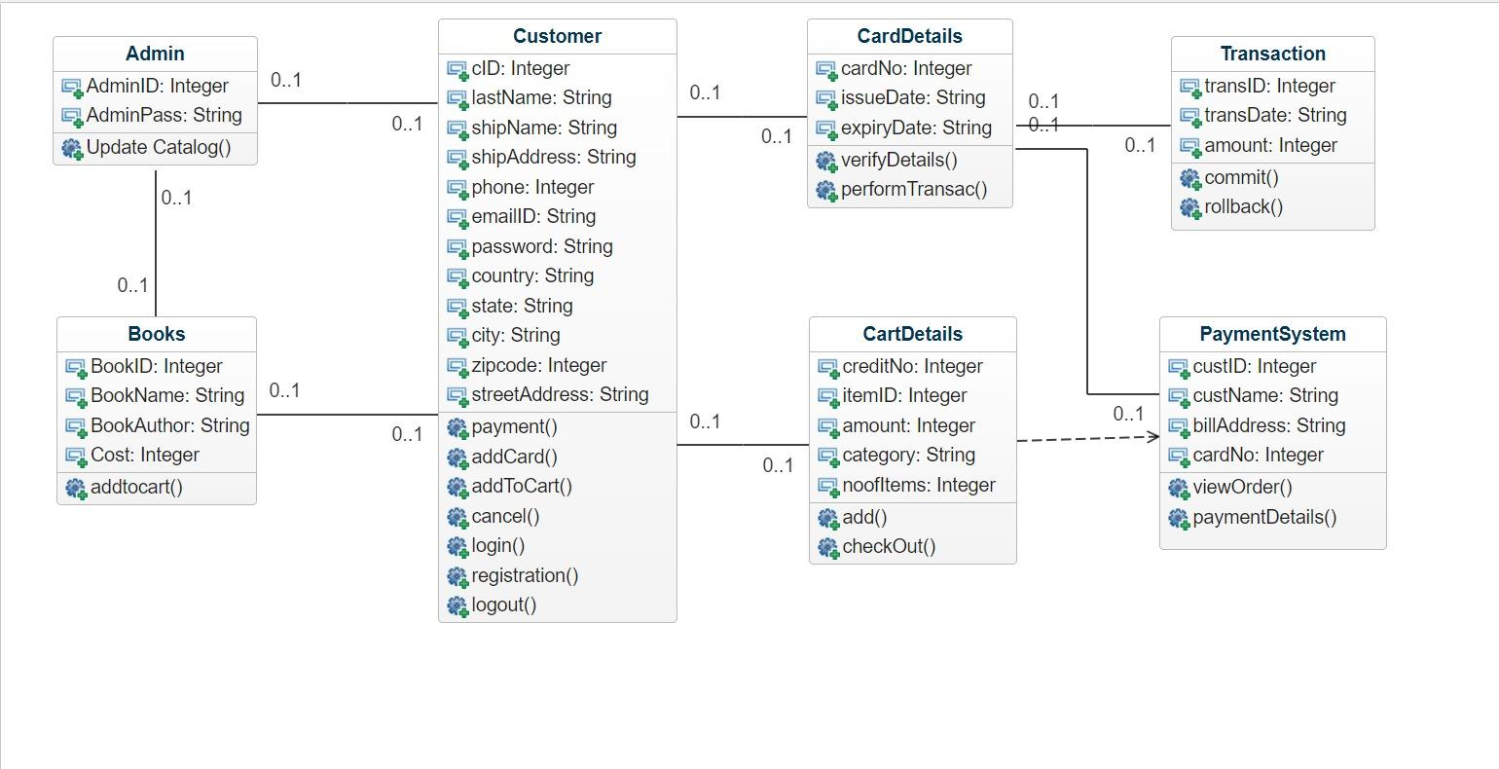
Class Diagram

Slide 20
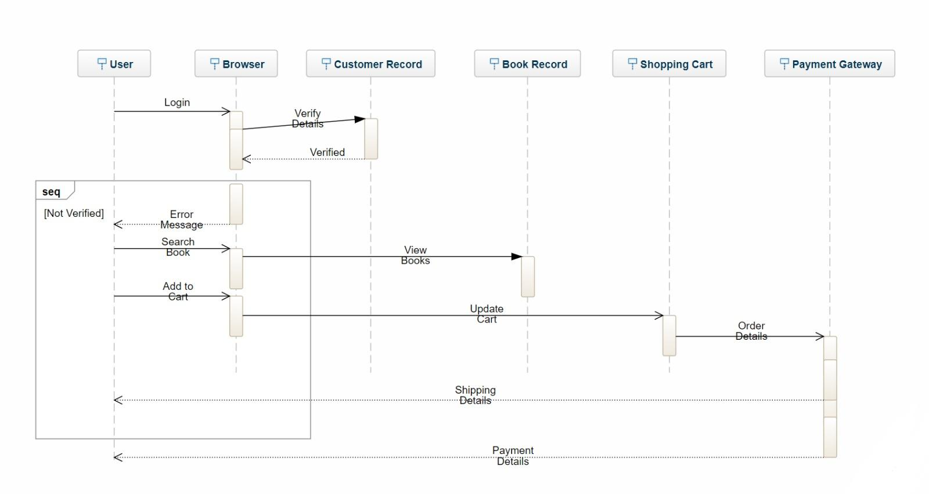
Sequence Diagram

Slide 21
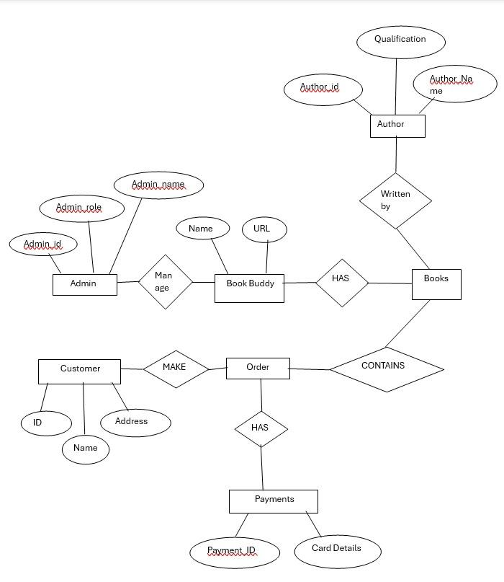
Entity Relationship Diagram

Slide 22
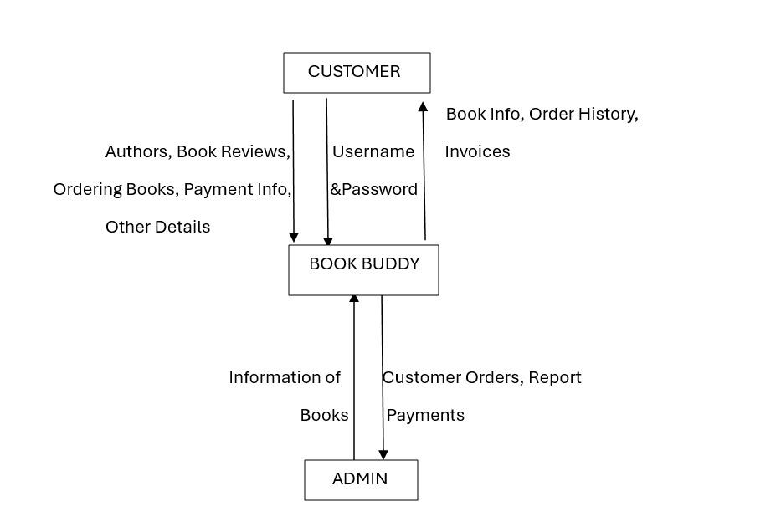
Context Diagram

Slide 23
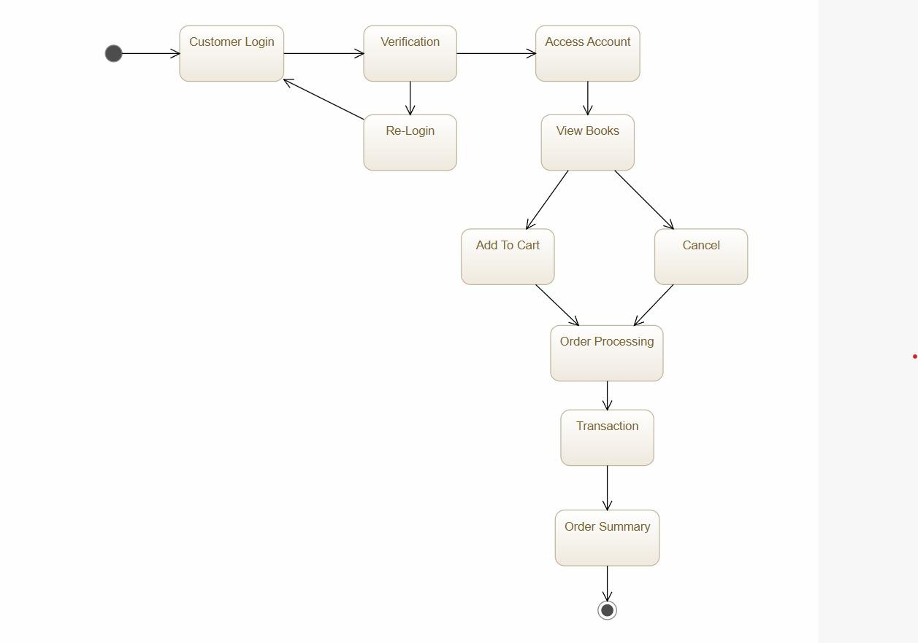
State Diagram

Slide 24
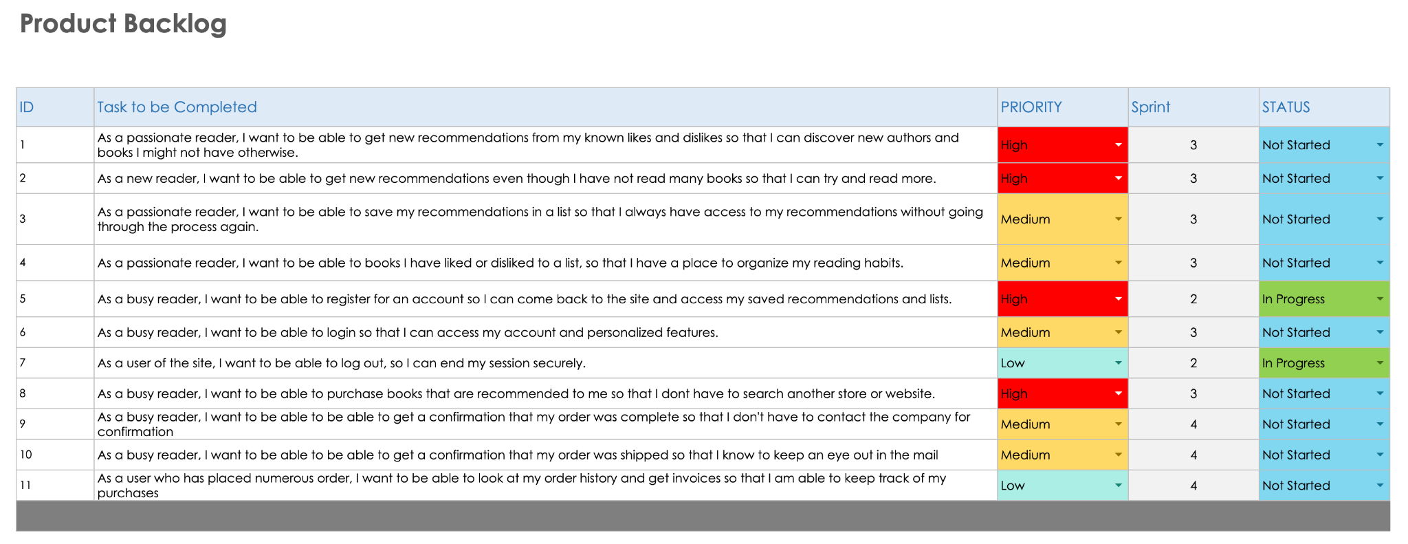
Product Backlog - Overview

Slide 25
User Stories in Detail
User Story 1:
As a passionate reader
I want to be able to get new recommendations from my known likes and dislikes
So that I can discover new authors and books I might not have otherwise.
Acceptance Criteria:
Given that the reader wants recommendations based off their likes and dislikes
When the reader requests recommendations
Then the system should serve those recommendations in a timely manner
The system should allow users to input their likes and dislikes
The recommendation system should take those parameters into account
The recommendations should include both well known and lesser know works
The recommendations should be presented in a visually appealing and easy-to-navigate format.
User Story 2:
As a new reader
I want to be able to get new recommendations even though I have not read many books
So that I can try and read more
Acceptance Criteria:
Given that the reader has not read many books in the past
When the reader requests recommendations
Then the system will ask general like and dislikes about certain genres to get a baseline
The system will have a short survey to get some information from reader with little to no reading history.
The system should offer a variety of genres and authors to help new readers explore different types of books.
The system should provide recommendations that are not overwhelming, considering the user's limited reading experience, a new reader should start with a smaller list of recommendations.

Slide 26
User Stories in Detail
User Story 3:
As a passionate reader
I want to be able to save my recommendations in a list
So that I always have access to my recommendations without going through the process again.
Acceptance Criteria:
Given that the reader wants to save their recommendations
When the system gives them the recommendations
Then the user will have an option to add them to a list
The lists should be easily accessible to the user.
The user should be able to view details about the books in the list.
The system should allow the user to add other books to the list found through searching or browsing the site.
User Story 4:
As a passionate reader
I want to be able to add books I have liked or disliked to a list
So that I have a place to organize my reading habits
Acceptance Criteria:
Given that the reader wants a way to organize their reading
When the user has a book they liked or disliked
Then they can add it to the list and mark it as such
The user should be able to have multiple lists and be able to name the lists.
The user should have a way to favorite, like or dislike books in their lists.
The user should be able to share/export lists to friends or other site users.

Slide 27
User Stories in Detail
User Story 5:
As a busy reader
I want to be able to register for an account
So that I can come back to the site and access my saved recommendations and lists
Acceptance Criteria:
Given that the reader wants to always have access to their lists
When the user comes to the site or tries to get recommendations
Then the site should prompt the user to register
The user should be able to register using third party logins and creating their own username/password.
The system will ask the user basic information to populate their user profile.
The system will send a confirmation email to the user when registration is complete.
User Story 6:
As a busy reader
I want to be able to login
So that I can access my account and personalized features
Acceptance Criteria:
Given that the user wants to access their personalized features
When the user inputs the correct username/password
Then the website will give them access to the resources requested
The system should display an error message if the user inputs the incorrect username/password combination.
After login, the user should be redirected to their personal dashboard or homepage.
The user should have a way to reset their password if it is forgotten.

Slide 28
User Stories in Detail
User Story 7:
As a user of the site
I want to be able to log out
So that I can end my session securely
Acceptance Criteria:
Given that the user wants to end their session
When the user clicks log out
Then the site will end that user session until they log in again
The site should have an easily accessible log out button.
After logout, it should provide a message or confirmation that log out was completed.
The logout button should redirect them to the home page or login page.
Logging out should clear any stored session information, such as cookies, to prevent unauthorized access to the account.
User Story 8:
As a busy reader
I want to be able to purchase books that are recommended to me
So that I don’t have to search another store or website
Acceptance Criteria:
Given that the user wants to purchase books
When the user finds a book they like
Then the site will offer a way to buy that book
The system should have a simple buy system.
The system will send the user a confirmation email when purchase is complete
The system will send shipping notifications to the customer

Slide 29
User Stories in Detail
User Story 9:
As a busy reader
I want to be able to get a confirmation email that my order was completed
So that I don’t have to contact the company for the status
Acceptance Criteria:
Given that the user wants an email receipt
When the user completes an order
Then the site will end send out a confirmation email including the order details
The confirmation will include an itemized receipt and a shipping estimation
User Story 10:
As a busy reader
I want to be able to get a confirmation email that my order was shipped
So that I know when the order ships and can watch my mail
Acceptance Criteria:
Given that the user a shipping confirmation
When the user’s order ships
Then the site will send this confirmation as soon as possible
The shipping confirmation should have the tracking number if applicable.

Slide 30
User Stories in Detail
User Story 11:
As a user who has placed multiple orders
I want to be able to look at my order history and get invoices
So that I can keep track of my purchases and spending
Acceptance Criteria:
Given the user wants to look at an order history
When the user has placed multiple orders
Then the site will have a section for a customer to look at their previous orders
The site will have an easy to read order history
The order history will include invoices with the items purchased and total spent.

Slide 31
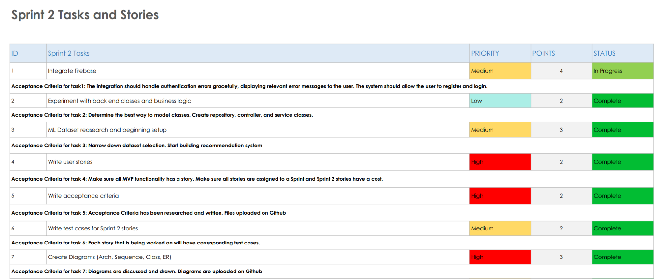
Sprint 2 Tasks, Stories, and Acceptance Criteria

Slide 32
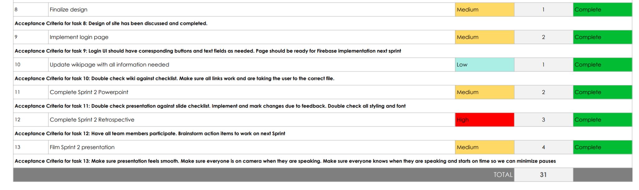
Sprint 2 Tasks, Stories, and Acceptance Criteria

Slide 33
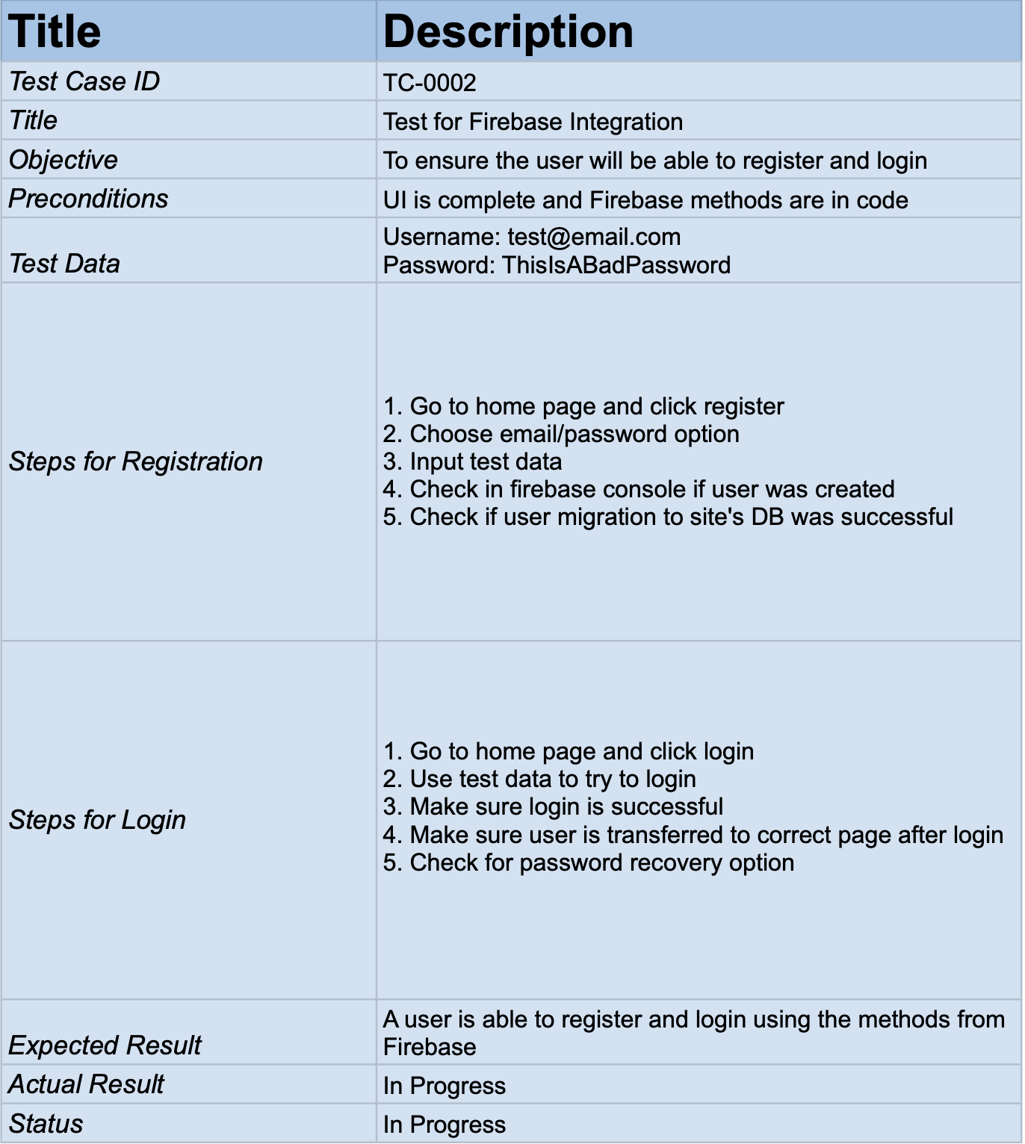
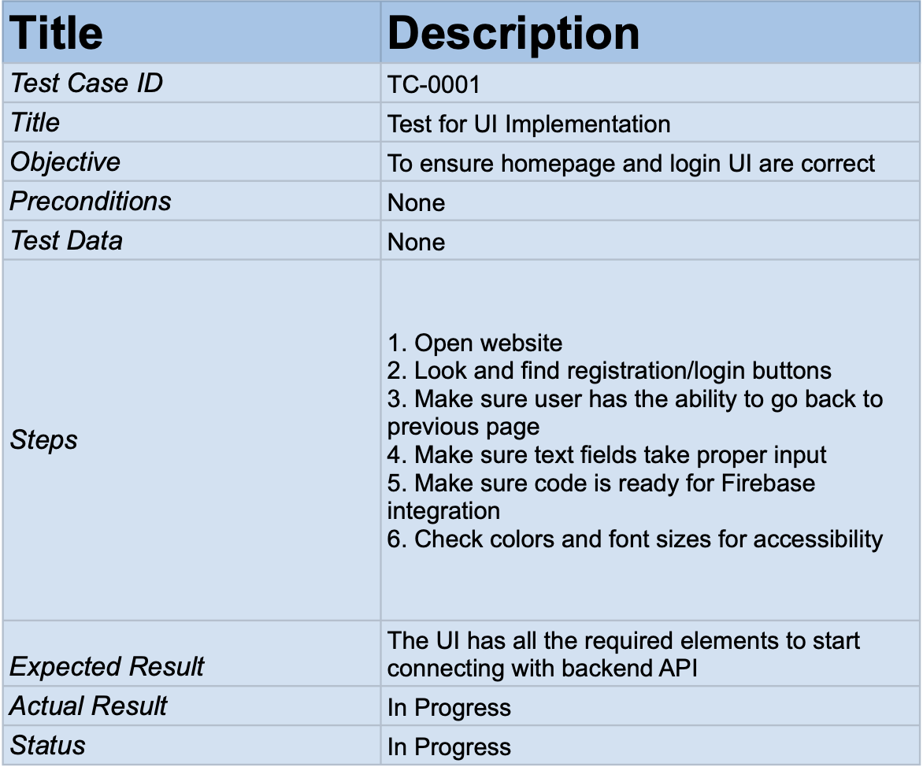
Sprint 2 Test Cases

Slide 34
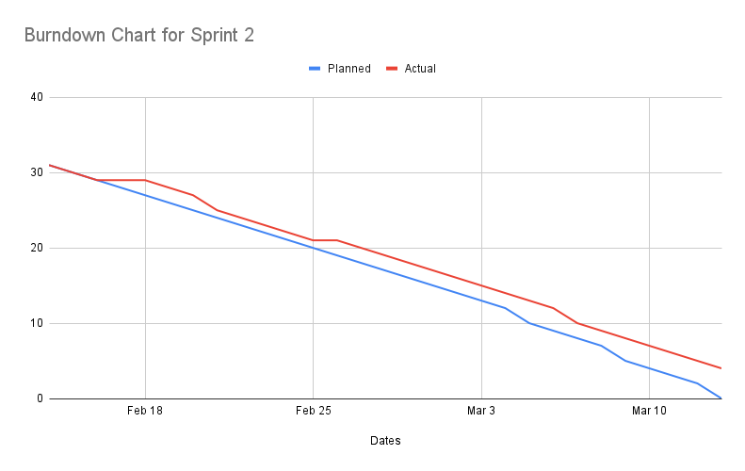
Sprint 2 Metrics and Burndown Chart
We still need to finish the Firebase Integration and that will be carried over to the next sprint
Team Velocity: Total points completed 27
Completed Committed Ratio: 31 total points - Ratio is 87%

Slide 35
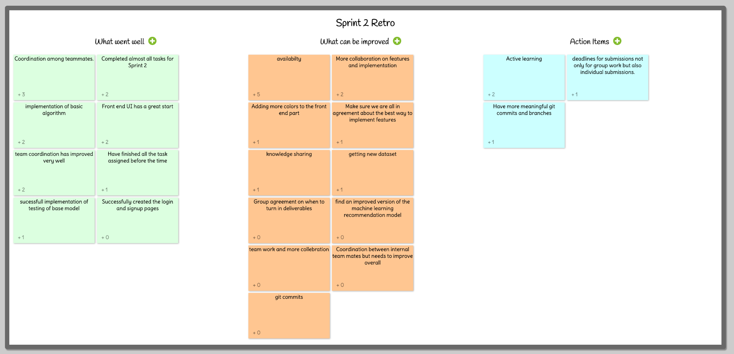
Sprint 2 Retrospective

Slide 36
Sprint 3 Plans
Stories from Sprint 2 carrying over:
Integrate Firebase Auth
New Stories for Sprint 3:
Implement and test ML algorithm
Implement backend classes and methods
Integrate firebase payment extension in backend
Fully test all implemented features
Technical Paper

Slide 37
Current Work on API
We are building the recommender systems as an external API.
The frontend will connect with this and send the input then receive recommendations.
We are also building our backend as a REST API. We are using the Spring Framework and during Sprint 2 we brainstormed and experimented with them.
The book recommendation and marketplace functionalities will use this backend.

Slide 38
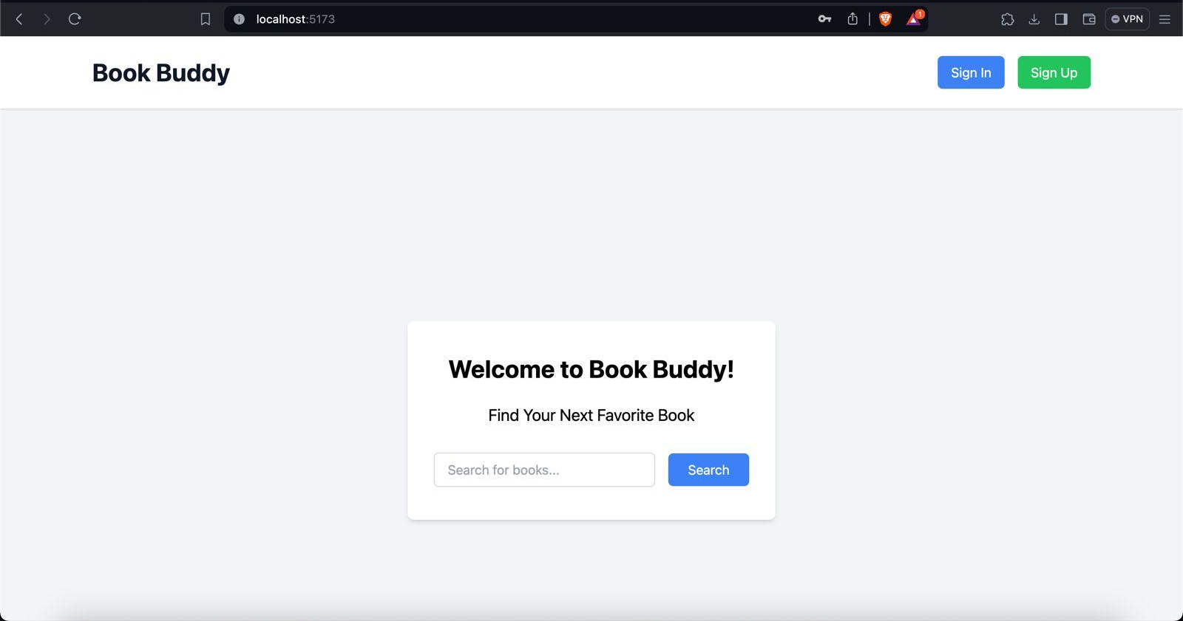
Demo Screenshots

Slide 39
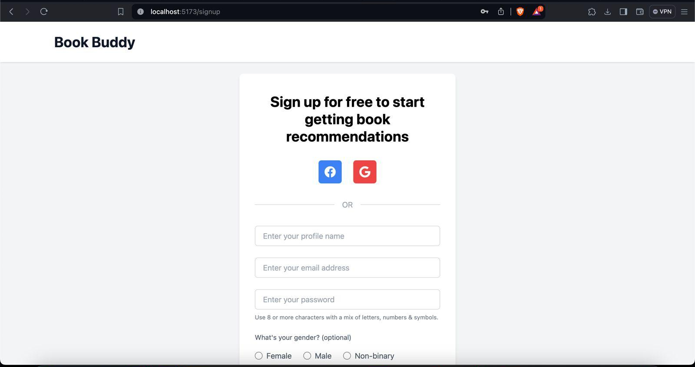
Demo Screenshots

Slide 40
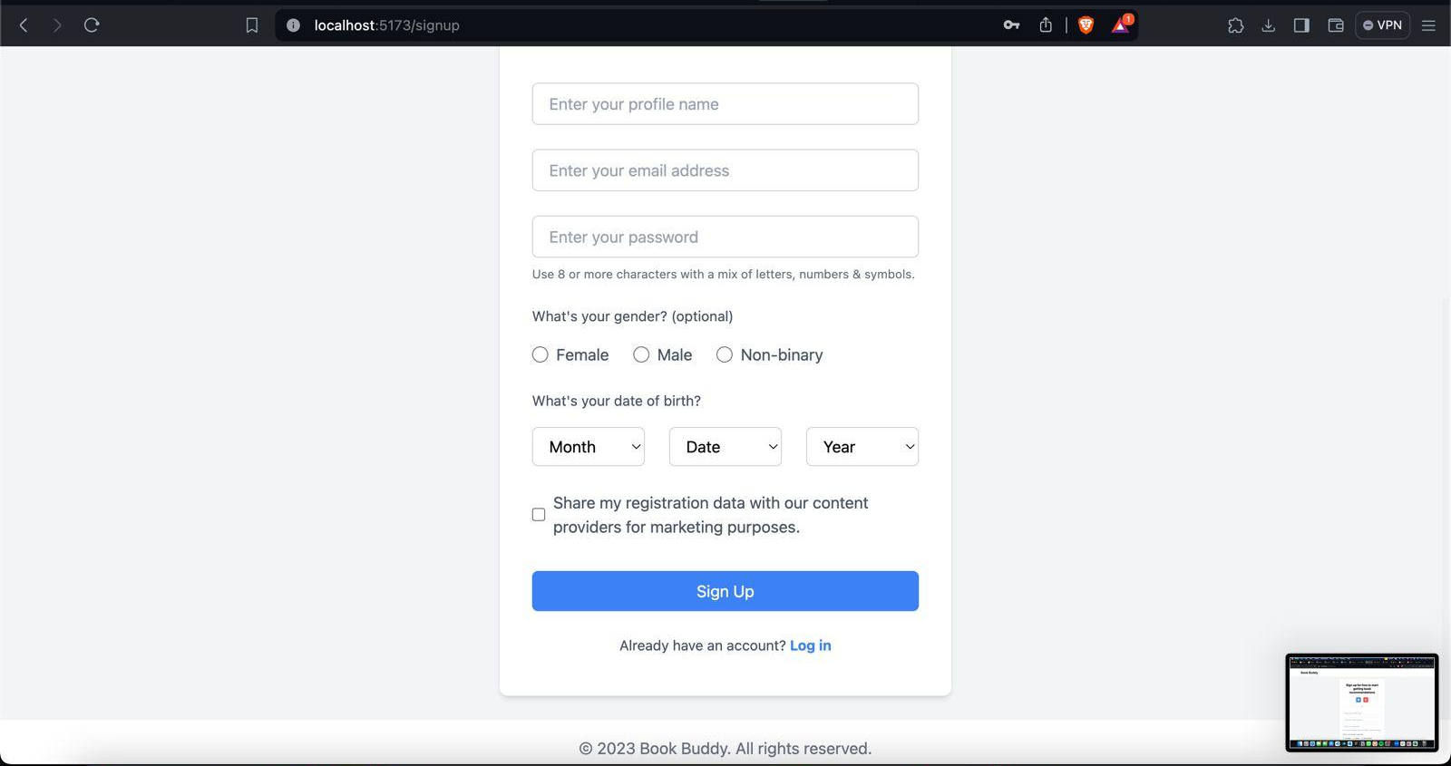
Demo Screenshots

Slide 41
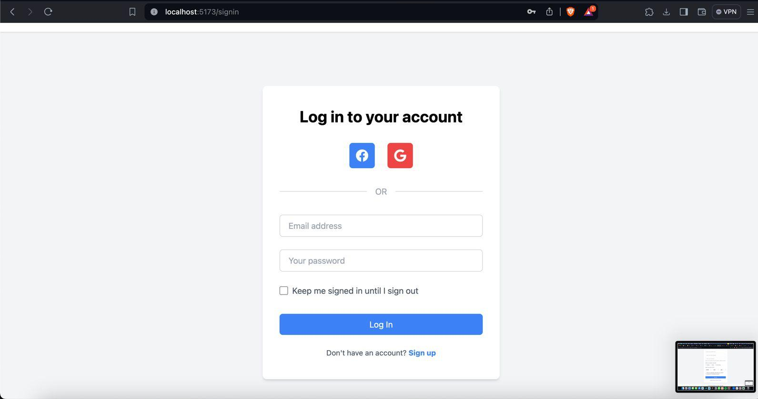
Demo Screenshots

Slide 42
WikiPage Link
https://github.com/htmw/2024S-Code-Avengers/wiki

Slide 43
Application Demo

